Slide 1
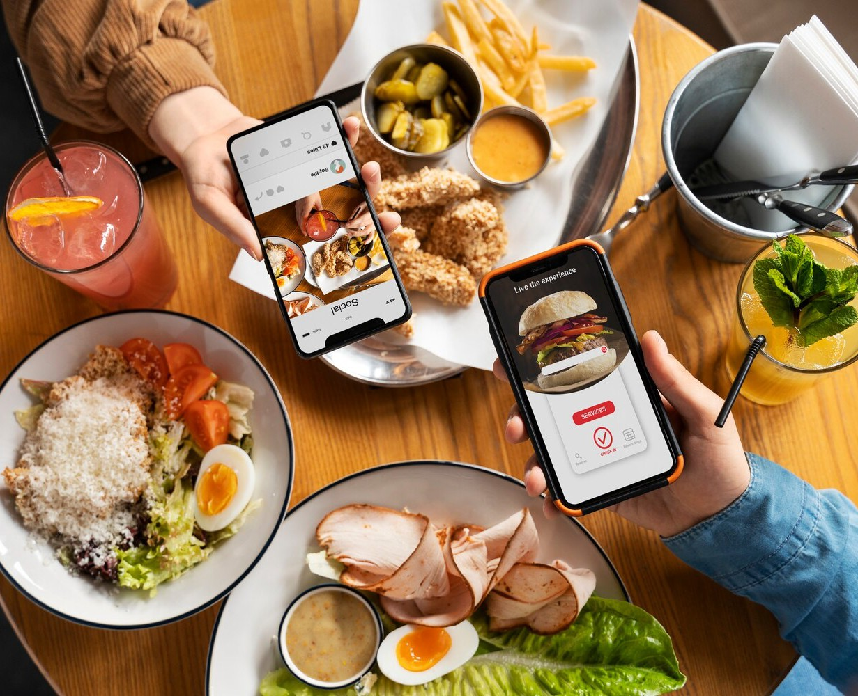
MenuAR: Transforming Dining Experiences
Revolutionize Your Restaurant with Augmented Reality
Presented By:
ROHAAN NADEEM (102)
SHEIKH QADEER (034)

Slide 2
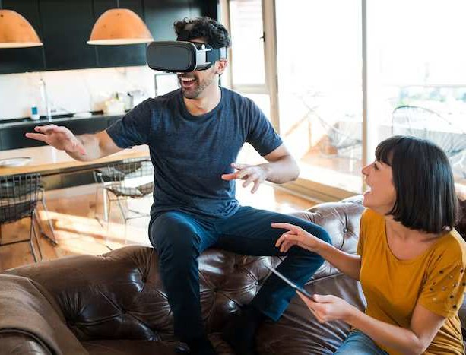
INTRODUCTION
Welcome to the future of dining with
MenuAR, an innovative
solution for restaurants.
Enhance customer experience and drive business growth, with less user disappointment and user friendly with
cutting-edge technology.

Slide 3

MARKET TRENDS
Discover the latest in dining technology and consumer preferences withbest UI design. Learn how is reshaping the restaurant industry and creating new opportunities for growth.
Opportunity for restaurants to stay ahead of the competition

Slide 4





Social media campaigns Partnerships with restaurants and inﬂuencers
MARKETING STRATEGY

Slide 5

Unaware of the application Good internet connection
Risks

Slide 6
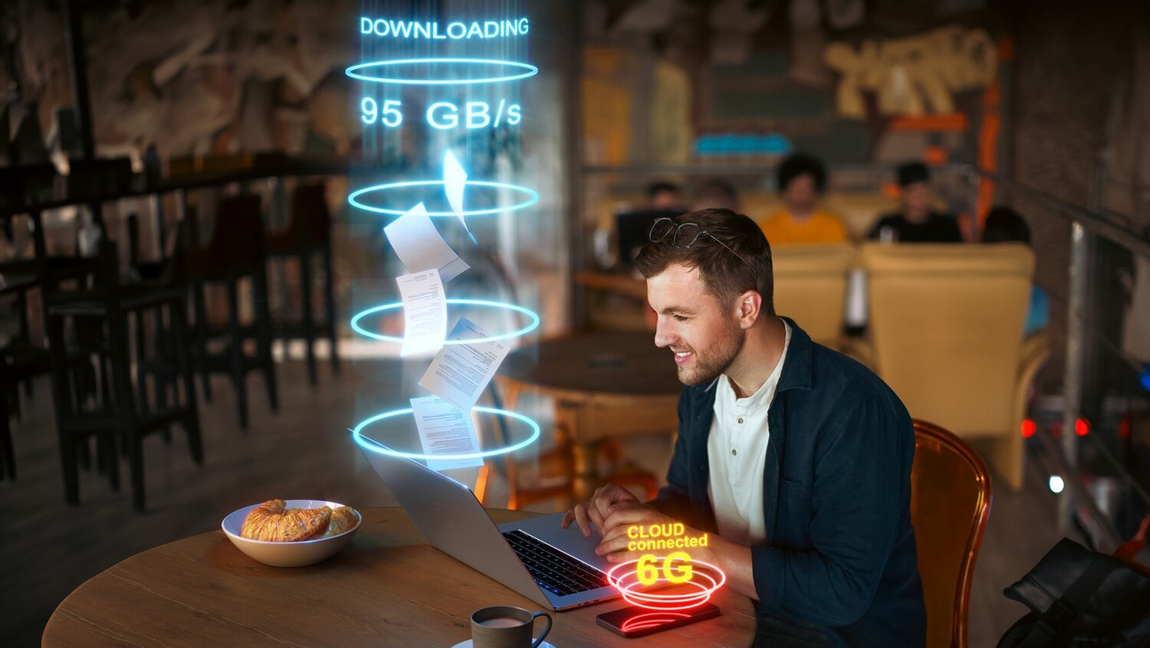
CUSTOMER EXPERIENCE
Immerse your customers in a captivating experience that brings menus to life.
Elevate the dining experience with interactive digital content, personalized recommendations, and engaging visuals.

Slide 7
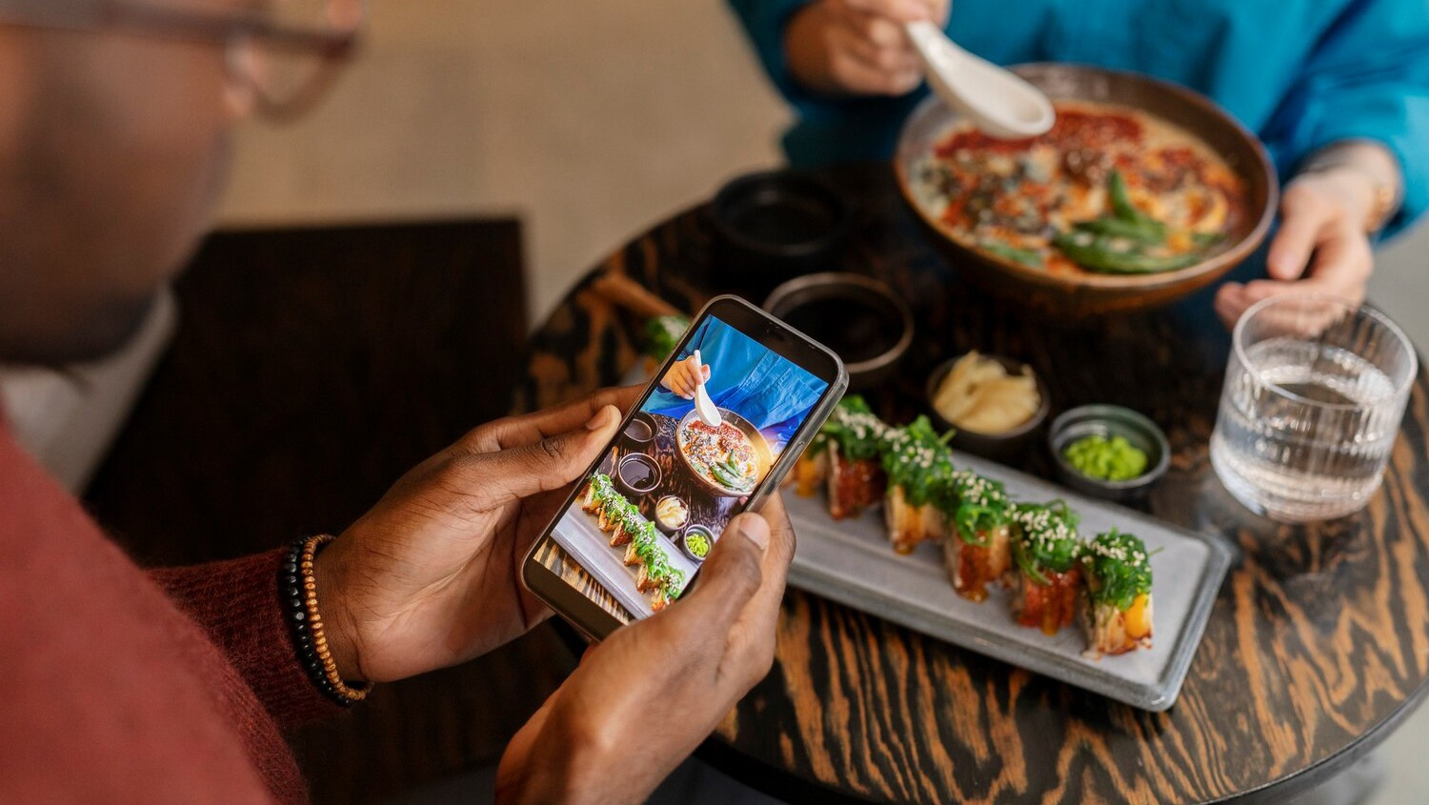
IMPLEMENTATION PROCESS
Onboarding and Setup Training Sessions Integration with Menus
Testing and Quality Assurance
Launch and Promotion Customer Engagement Monitoring and Support
Updates and Future Enhancements

Slide 8

ROI AND BUSINESS IMPACT
Elevate customer satisfaction with immersive 3D models.
Streamline operations, reducing errors and operational costs.
Gain a competitive advantage as an innovative dining destination.
Utilize MenuAR as a marketing magnet, driving foot trafic and visibility.
Experience revenue growth through
increased engagement.

Slide 9
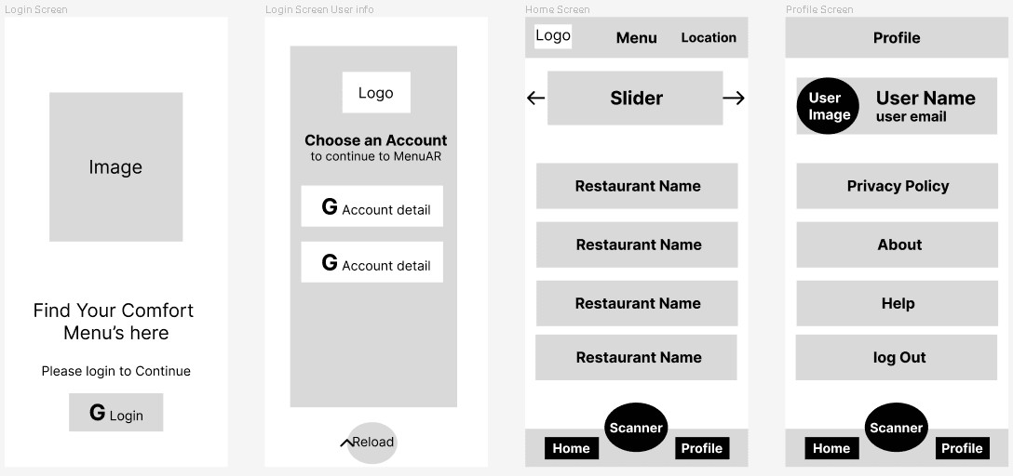

WIREFRAME OF APPLICATION
https://www.ﬁgma.com/ﬁle/TSe6ncaypZkEamvwi2hK1H/Mobile-App-Development- Lab-Project?type=design&node-id=0%3A1&mode=design&t=oXMyvAkI4zOh18RJ-1

Slide 10
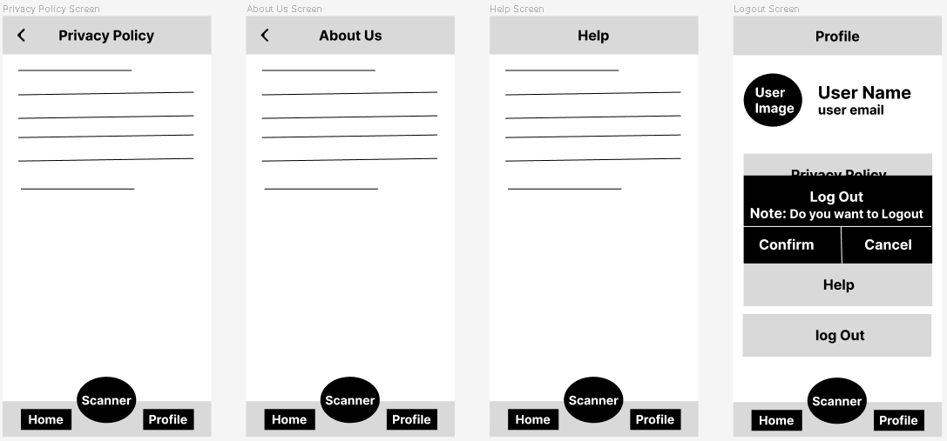
WIREFRAME OF APPLICATION
https://www.ﬁgma.com/ﬁle/TSe6ncaypZkEamvwi2hK1H/Mobile-App-Development- Lab-Project?type=design&node-id=0%3A1&mode=design&t=oXMyvAkI4zOh18RJ-1

Slide 11
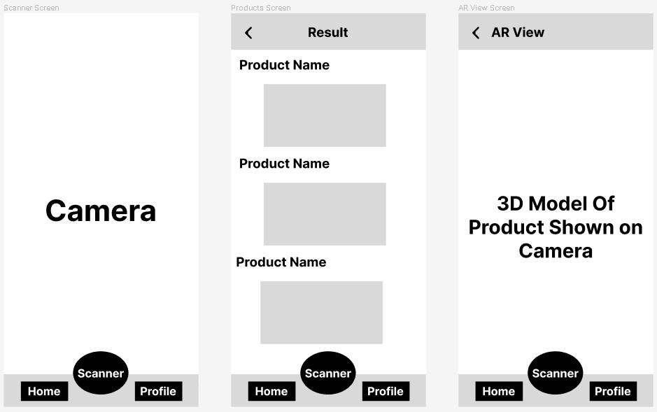
WIREFRAME OF APPLICATION
https://www.ﬁgma.com/ﬁle/TSe6ncaypZkEamvwi2hK1H/Mobile-App-Development- Lab-Project?type=design&node-id=0%3A1&mode=design&t=oXMyvAkI4zOh18RJ-1

Slide 12
CONCLUSION
Embrace the future of dining with . Elevate your restaurant's ofering, delight your customers, and stay ahead of the competition with this cutting-edge technology.

Slide 13
Thanks!
Do you have any questions? rohaannadeem2@gmail.com
+92 308 4439359
Rohaan02@github.io

